Slide 1





PRESENTATION
GAME EVENT
PRESENTER: TRAN THI TAI LINH

Slide 2

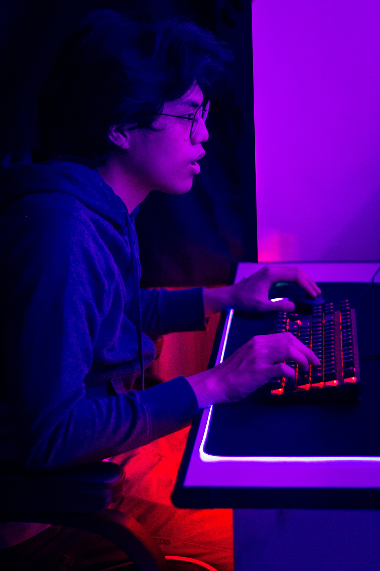
TABLE OF CONTENTS
01
02
03
04
Purpose Statement
Tell Data Story
Conclusion
Recommendation

Slide 3


PURPOSE
OBJECTIVE
Identify the following analysis related to churn, revenue and some recommendations improve future events in terms of participation and revenue in a special event in the game.

Slide 4
PRESENT DATA

Slide 5

SUMMARY
TOTAL PLAYER LEVEL
TOTAL MISSION
TOTAL CHAPTER
41
17
5
HIGHEST STARTING MISSION
AVERAGE PREMIUM CURRENCY
AVERAGE REVENUE
423821
103,43 $
109,85 $

Slide 6
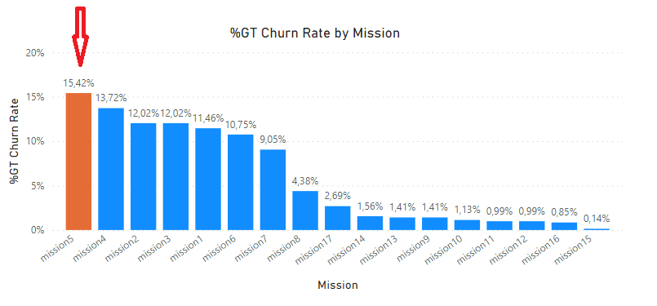
CHURN ANALYSIS
MISSONS
Churn Rate vary widely by missions
Mission 5 had the highest Churn Rate at 15,42%, followed by mission 4 and mission 2
Why mission 5 has the highest Churn Rate of all?

Slide 7
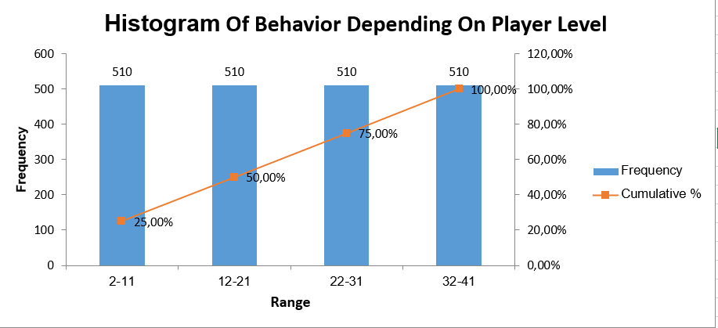
CHURN ANALYSIS
BEHAVIOR
Players level are grouped in 4 level groups which accounted for 25% each
Player level appears at a constant rate
The cumulative curve is linear, player level is not changing

Slide 8
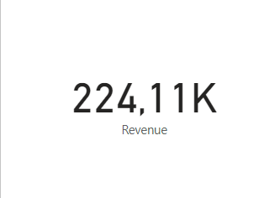
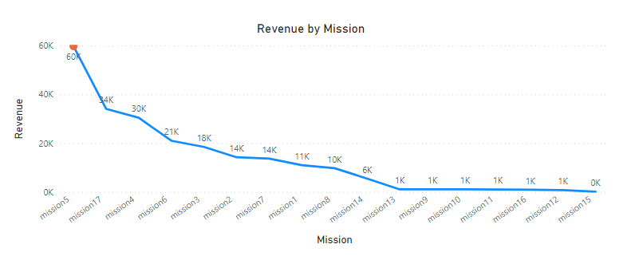
REVENUE ANALYSIS
MISSION
The event generates 22,411,138 $
Mission 5 had the highest revenue by mission at nearly 60K which accounted for at 26,67%,
Is there any relationship between churn rate and revenue in mission 5?

Slide 9
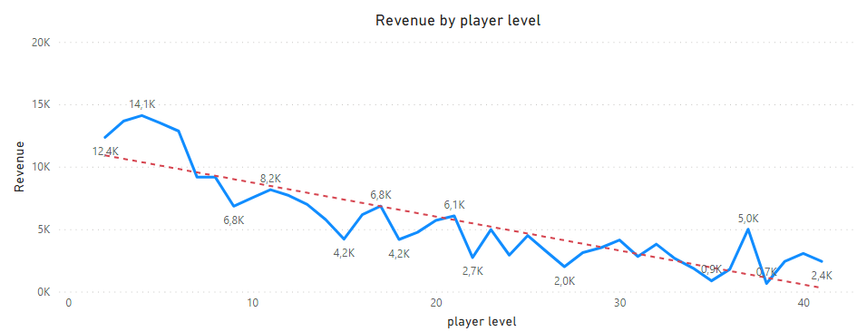
REVENUE ANALYSIS
LEVEL
Level 4 had the highest revenue at 14K, followed by level 3 and level 5
There is a downtrend line in the relationship between revenue and player level

Slide 10
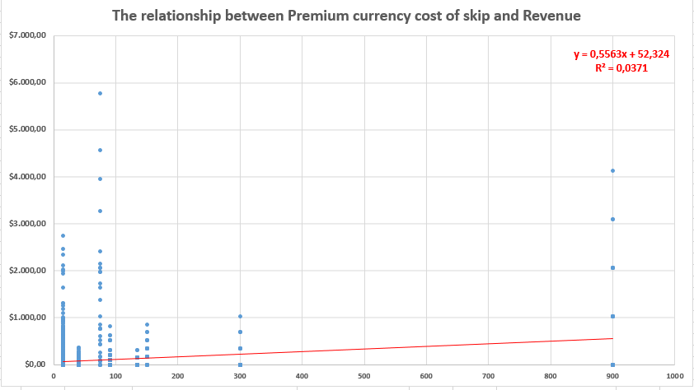
REVENUE ANALYSIS
Little correlation between Premium currency cost of skip and Revenue
R-squared (=0,0371) is weak

Slide 11
CONCLUSION

Slide 12


Due to the game complexity in mission 5, players tend to pay premium currency to skip, resulted in the highest revenue of all
01
02
Steady amount of players participate in the event
03
Difficulty levels are not adjusted approximately (mission 5 had the highest Churn Rate, whereas mission 15 had the lowest )

Slide 13
RECOMMENDATION

Slide 14

Recommendations
Cost | Recommendation | Pros | Cons
Advertising & Marketing | - Focus on target audience according to their location, age, and gender (PvP, FPS, MOBA,…) - Integrate rewarding video ads into game. Make an in-app purchase (IAP) through click-through rate Make a variety of advertisements | - Reduce costs on ineffective marketing campaigns - Discover insights that helps target customers better - Increase ARPDAU and ARPPU. | Require training to upskill employees
Player Experience | - Create an Easy First-Session Experience - Simply navigate through the interface Give a platform to communicate (game community for the event) - Adjust the appropriate difficulty levels in game | - Positive affect user interaction (new play modes, content, daily or weekly tasks) - Players feel like there problems have been solved | Too much responses to answered good enough to players
Selling & Distribution | - Create a loyalty program, offer points, rewards, coupons or anything relevant to the event and valuable to customers. - Adjust pricing model (there is not much variety in pricing) - Use A/B testing to identify key times of day, month and even year, where up-selling and cross-selling are most effective. | Increase ARPU, help to focus on those users that have the highest growth potential. | Any kind of sudden pricing changes will likely disappoint loyal users
General & Administration | - Search for alternatives of stationery for affordable price and similar quality - Improve Customer Support for positive customer experiences | Reduce unnecessary items and expenses Save time as procedures are carried out on digital platforms | Require training to upskill employees Low feasibility/Reduce expenses insignificantly

Slide 15
THANK'S FOR WATCHING

